Slide 1

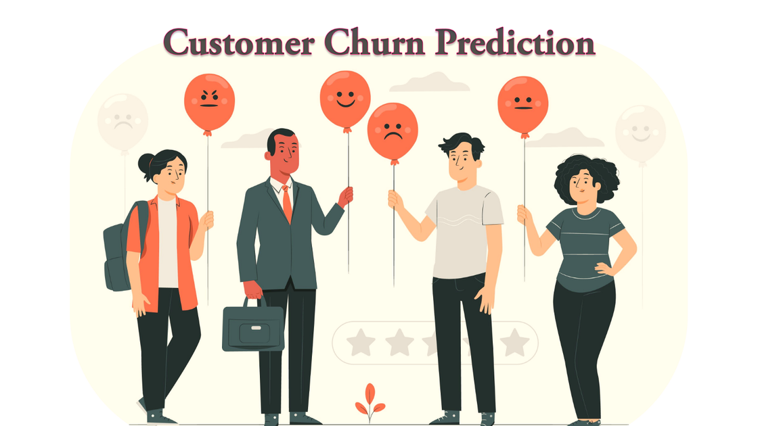
TELECOM CUSTOMER CHURN PREDICTON
By Mrunalini Yeole

Slide 2

What is Customer Churn?
Customer churn, a prevalent issue in the telecom industry, occurs when customers discontinue using a company's services. With annual churn rates typically ranging from 15-25 percent, the industry faces intense competition among numerous service providers.
Due to the large customer base and associated costs, personalized retention efforts for each customer are impractical. However, identifying at-risk customers in advance allows for targeted retention strategies, optimizing resources and enhancing customer loyalty. Telecom companies aim not only to retain existing customers but also to expand their market share by attracting new ones.
Recognizing the economic benefits of customer retention over acquisition, telecom companies actively seek to detect potential churn indicators proactively. This requires a comprehensive understanding of customer behavior across various touchpoints. By addressing churn early, companies can protect their market position and drive growth and profitability.

Slide 3

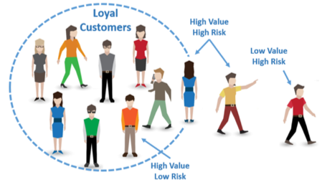
OBJECTIVE
Finding the % of Churn Customers and customers that keep in with the active services.
Analyzing the data in terms of various features responsible for customer Churn
Finding a most suited machine learning model for correct classification of Churn and non churn customers.

Slide 4
DATASET
Dataset Name: Customer_churn.csv
The data set includes information about:
Customers who left within the last month – the column is called Churn
Services that each customer has signed up for – phone, multiple lines, internet, online security, online backup, device protection, tech support, and streaming TV and movies
Customer account information – how long they’ve been a customer, contract, payment method, paperless billing, monthly charges, and total charges
Demographic info about customers – gender, age range, and if they have partners and dependents

Slide 5
IMPLEMENTATION
LIBRARIES:
1. SKLEARN
2. PANDAS
3. NUMPY
4. SEABORN
5. MATPLOTLIB

Slide 6
DATA PREPROCESSING
1.
df.info() -> This is used to get the information about all the columns in the dataset
2.
df.isnull() -> This is used to check the nul values in the dataset
df.dropna() -> This is used to remove all the null values in the dataset or we can use with respect to a particular columns also.
3.
4.
df.fillna() -> This is used to fill the missing values with mean, median or mode whichever we want to fill it with.
4.
Label Encoder -> It is used to convert the categorical values into numerical values

Slide 7


EDA
Exploratory Data Analysis (EDA) is a critical phase in the data analysis process that involves examining and understanding the characteristics of a dataset before applying any formal statistical techniques.
It encompasses a variety of techniques and methodologies aimed at summarizing the main features of the data, often using visual methods such as histograms, scatter plots, and box plots.
EDA serves several purposes, including detecting patterns, identifying outliers, understanding the distribution of variables, and exploring relationships between variables.
By conducting EDA, analysts can gain insights into the underlying structure of the data, which informs subsequent modeling decisions and helps ensure the validity and reliability of any conclusions drawn from the data analysis

Slide 8
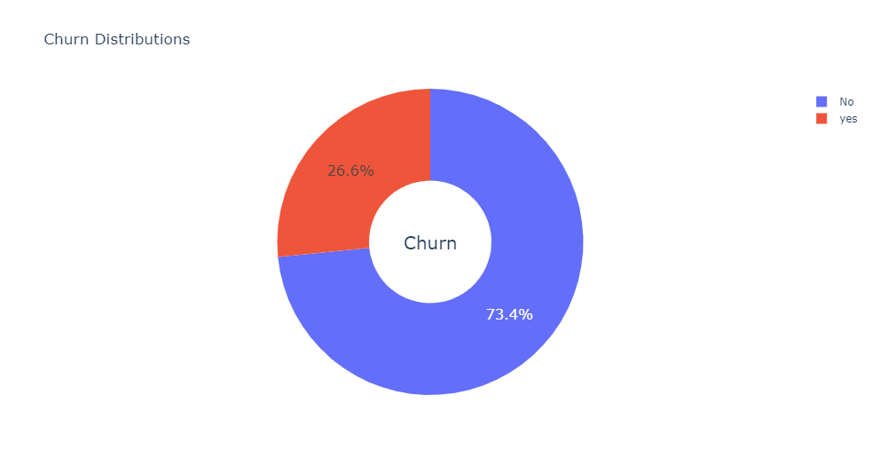
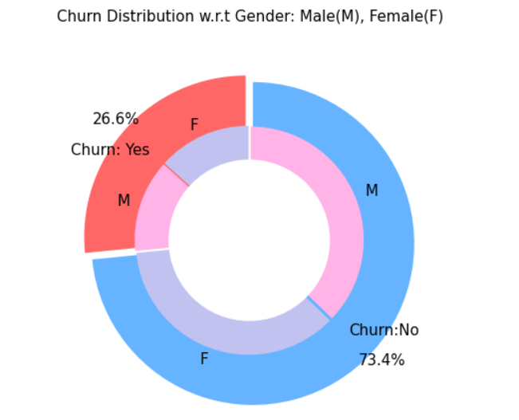
Churn distributions
2 . Churn distributions with respect to gender
There is negligible difference in customer percentage/count who changed the service provider. Both genders behaved in similar fashion when it comes to migrating to another service provider/firm.
We can say that about 26.6% customers switch to another firm while 73.4% customer remains to continue the service.

Slide 9
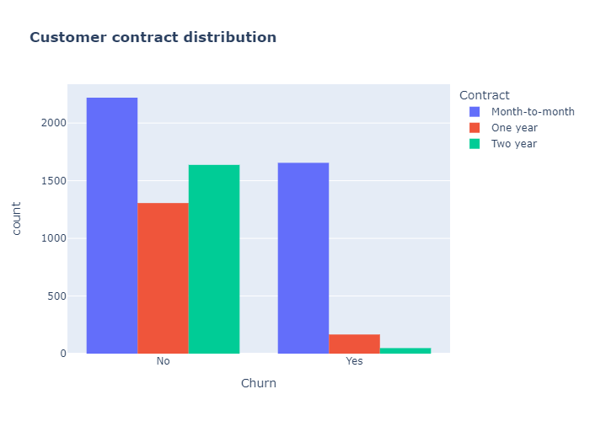
3 . Customer Contract Distributions
About 75% of customer with Month-to-Month Contract opted to move out as compared to 13% of customrs with One Year Contract and 3% with Two Year Contract

Slide 10
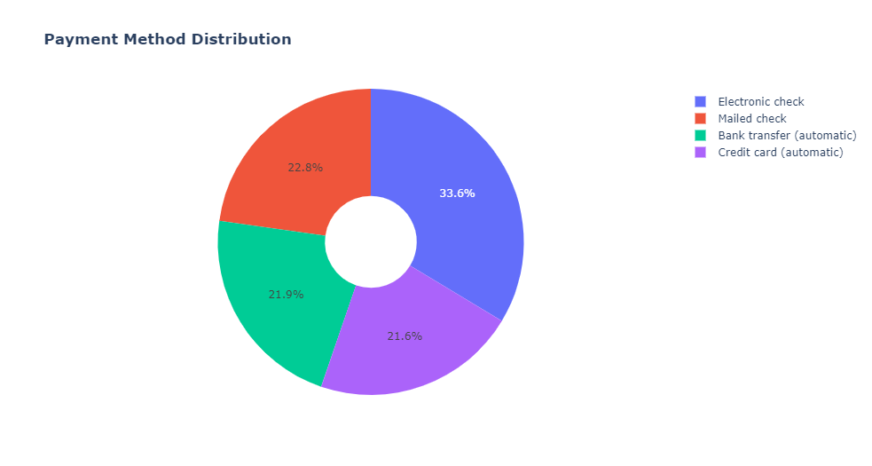
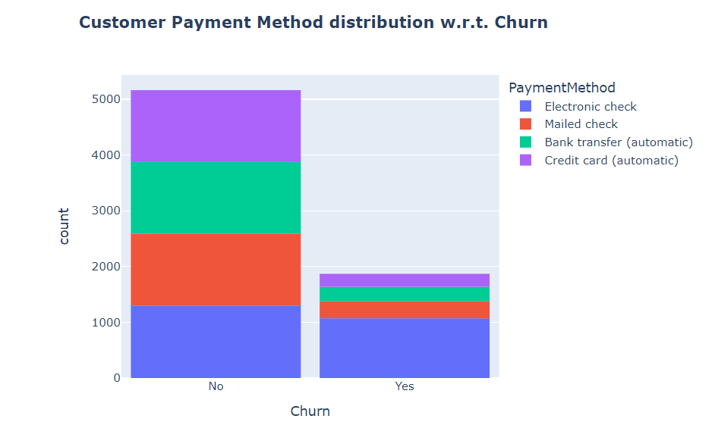
4 . Payment Methods
Major customers who moved out were having Electronic Check as Payment Method. Customers who opted for Credit-Card automatic transfer or Bank Automatic Transfer and Mailed Check as Payment Method were less likely to move out.

Slide 11
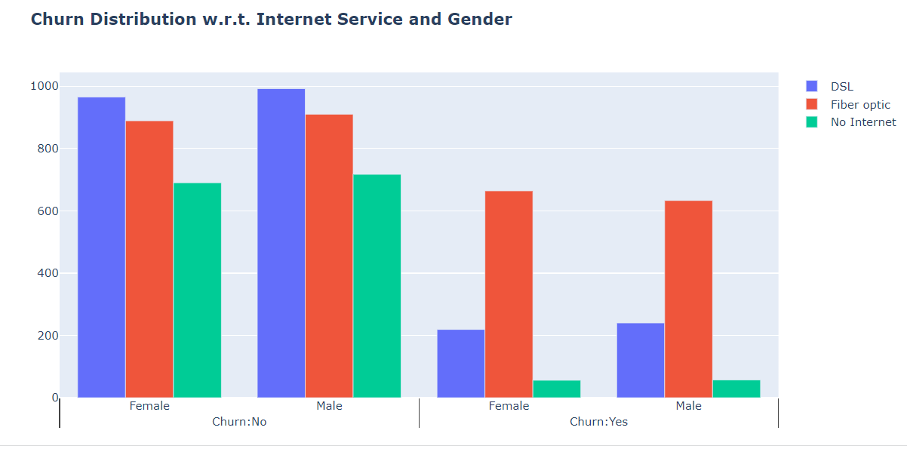
5 . Internet Services
Several customers choose the Fiber optic service and it's also evident that the customers who use Fiber optic have high churn rate, this might suggest a dissatisfaction with this type of internet service. Customers having DSL service are majority in number and have less churn rate compared to Fibre optic service.

Slide 12
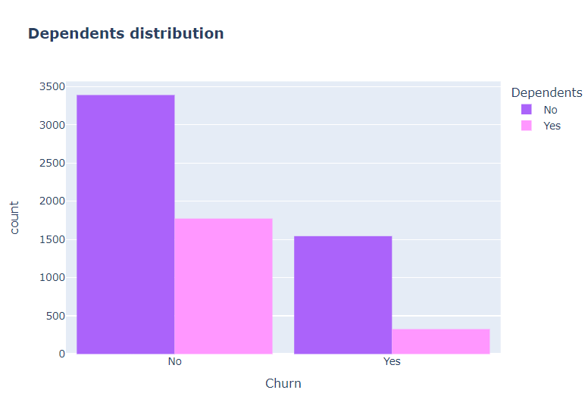
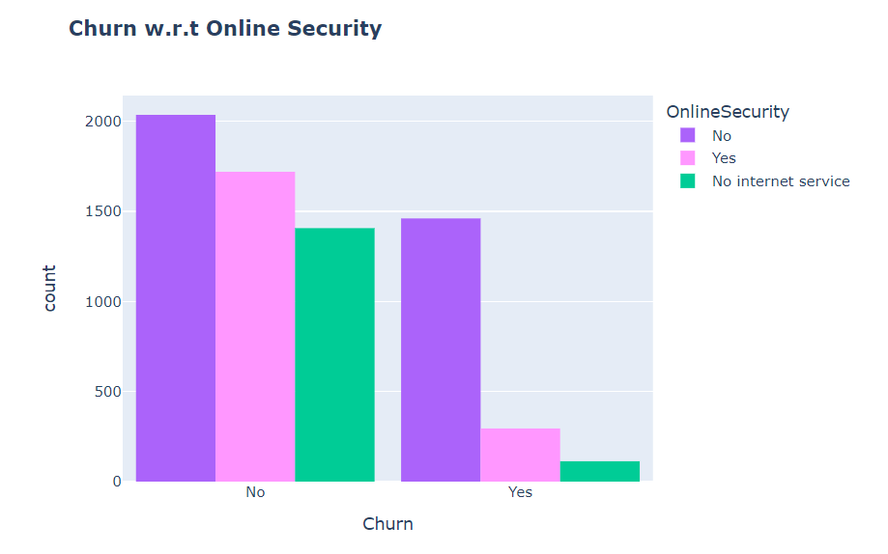
6 . Dependents Distributions
7. Online Security
Customers without dependents are more likely to churn.
As shown in following graph, most customers churn due to lack of online security

Slide 13
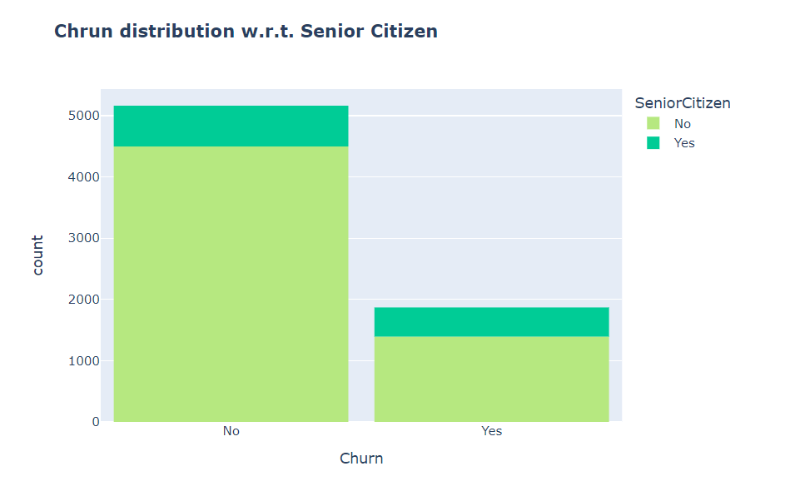
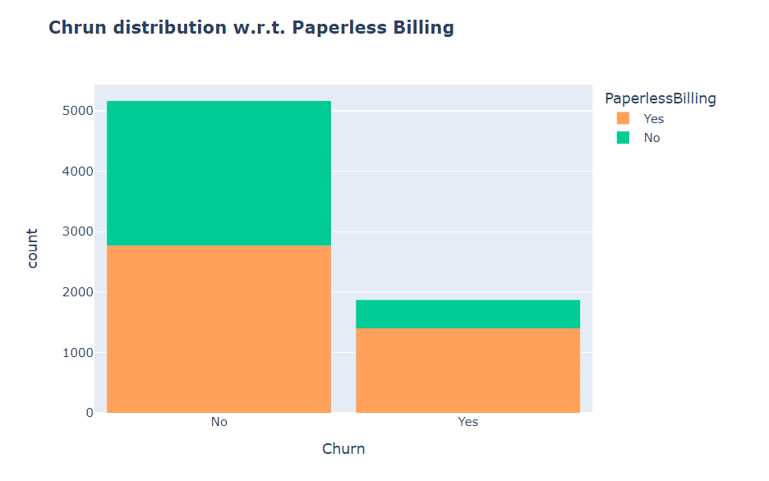
8 . Senior Citizen
9. Paperless Billing
Most of the senior citizens churn; the number of senior citizens are very less in over all customer base.
Customers with Paperless Billing are most likely to churn.

Slide 14
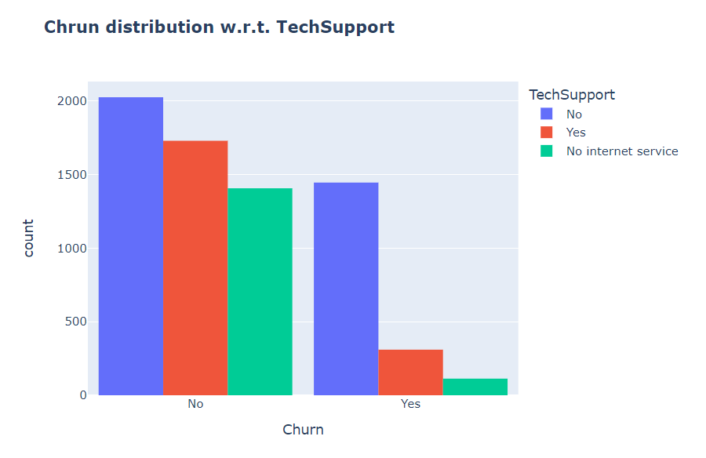
10 . Tech Support
As shown in following chart, customers with no TechSupport are most likely to migrate to another service provider.

Slide 15
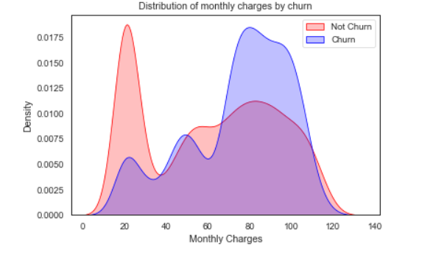
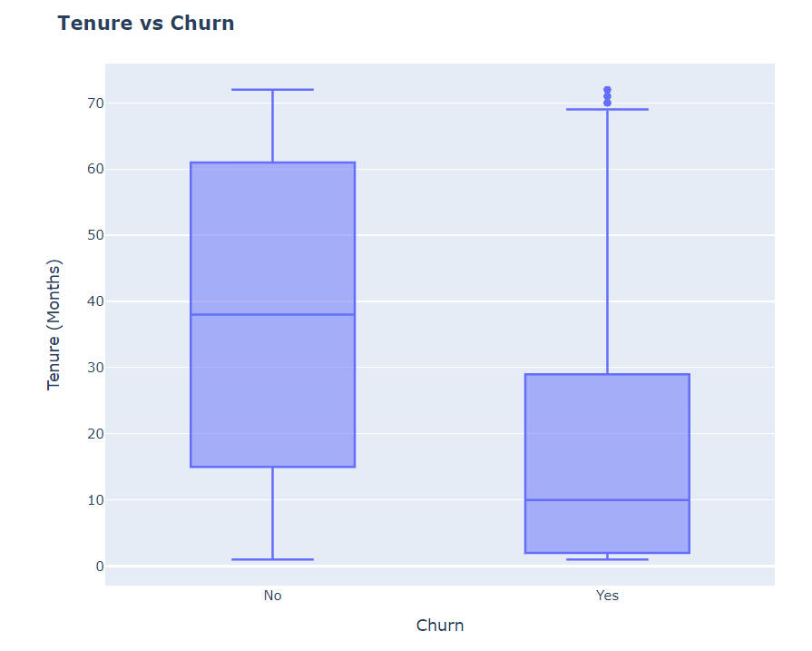
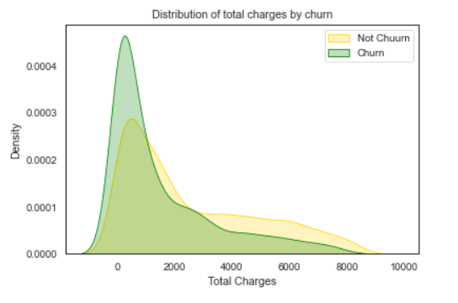
11 . Distributions w.r.t. charges and tenure
Customers with higher Monthly Charges are also more likely to churn.
New customers are more likely to churn.

Slide 16
MODEL BUILDING
Random Forest
Logistic Regression
Random Forest is favored in telecom for churn prediction due to its robustness and accuracy. By aggregating predictions from diverse decision trees, it handles overfitting and captures complex customer attribute interactions, aiding in effective churn prediction and resource allocation, thereby enhancing customer satisfaction and reducing churn rates.
In the telecommunications industry, logistic regression is commonly used for customer churn prediction due to its simplicity and interpretability. By analyzing customer data such as call patterns and service usage, logistic regression models can estimate the likelihood of churn, enabling telecom companies to implement targeted retention strategies and optimize customer satisfaction.
Decision Tree
Decision tree algorithms are preferred in telecom for churn prediction due to their simplicity and interpretability. They analyze customer data to segment customers based on churn probabilities, enabling proactive retention strategies and optimization of products/services to enhance customer retention and profitability.

Slide 17
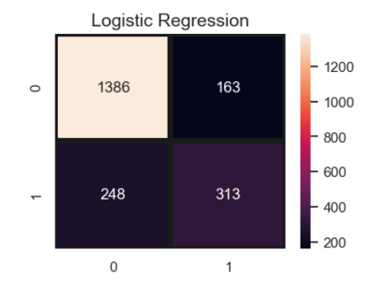
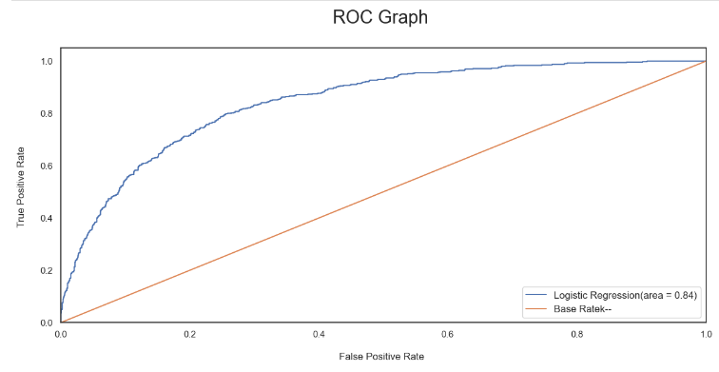
Model evaluations and predictions
Logistic Regression

Slide 18
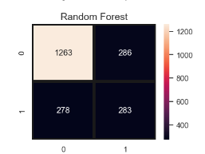
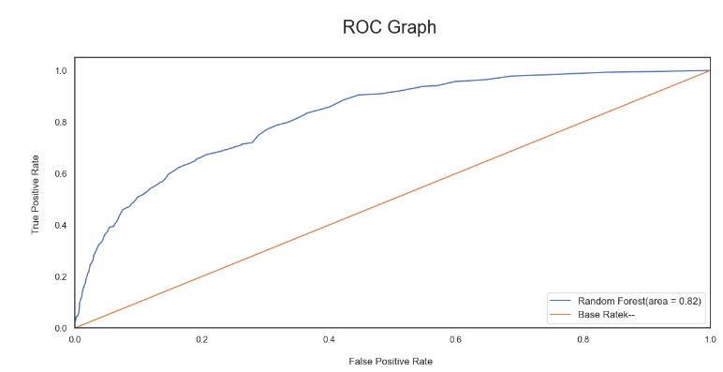
Model evaluations and predictions
Random Forest

Slide 19
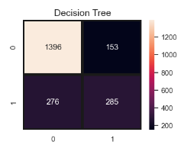
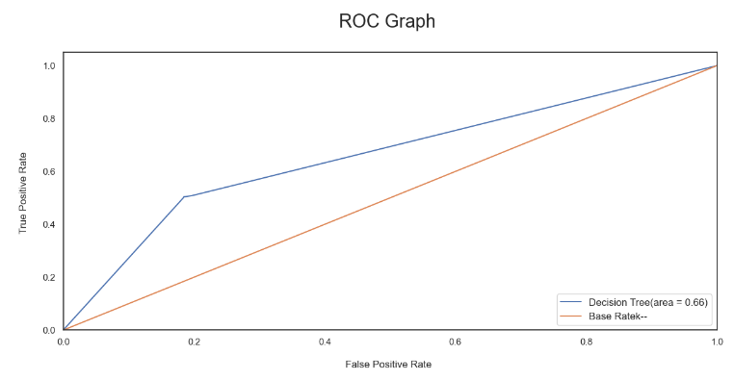
Model evaluations and predictions
Decision Tree

Slide 20
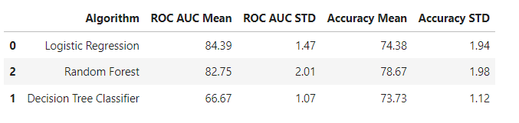
Model evaluations and predictions
In this way, we can say that the random forest algorithm is the best model for customer churn prediction than the logistic regression and decision tree.

Slide 21
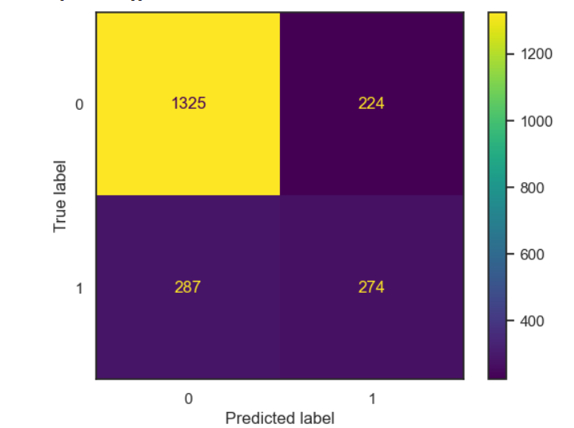
Model evaluations and predictions
Now, we combine all the three algorithms or methods to predict the final overall result of the model. For this we will use voting classifier which will combine logistic regression, random forest and decision tree.
Out of a total of 2110 instances, the model correctly identified 1325 instances as churn (True Positives) and 274 instances as non-churn (True Negatives). However, it incorrectly classified 224 instances as churn when they were actually non-churn (False Positives) and 287 instances as non-churn when they were actually churn (False Negatives). This matrix provides valuable insights into the model's strengths and weaknesses, which can be used to refine predictive strategies and optimize customer retention efforts.

Slide 22
RESULT AND CONCLUSION
After conducting customer churn prediction in the telecommunication industry using logistic regression, decision tree, and random forest algorithms, several key findings emerge.
We came to now that the best algorithms which can be used for the customer churn prediction is the random forest when we have applied all the three algorithms independently.
After implementing voting classifier which combines all the three algorithms, the overall or the final accuracy of the model is 0.75781

Slide 23
THANK YOU

